Slide 1
Md. Nur A Neouse Id. 193002093 Department of CSE CSE-201 Presentation on Cyber security

Slide 2
What is Cybersecurity?
The term cyber security is used to refer to the security offered through on-line services to protect your online information.
Cyber Security and Information Security differs only in its response and Reduction/Prevention.

Slide 3
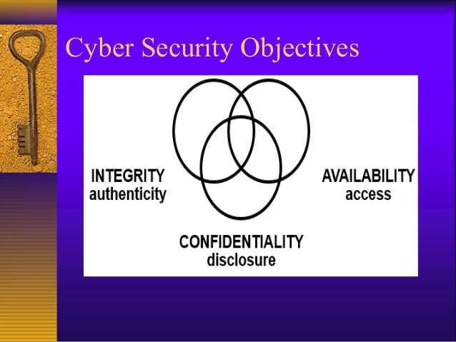
Cyber Security Objectives

Slide 4

Confidentiality
The property that information is not made available or disclosed to unauthorized individuals, entities, or processes

Slide 5
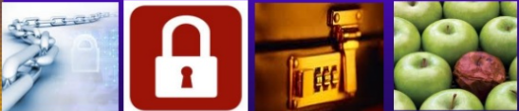
Integrity
Integrity the property of safeguarding the accuracy and completeness of assets

Slide 6
Availability
Availability means that information is accessible by authorized users.
Information and other critical assets are accessible to customers and the business when needed.

Slide 7
Cyber attack
A malicious attempt, using digital technologies, to cause personal or property loss or damage, and/or steal or alter confidential personal or organizational data

Slide 8
Major security problems
Virus
Hacker
Malware
Trojan horses
Password cracking

Slide 9
The Different Forms of Cybersecurity Threats
Denial-of-service (DoS) Attacks
Man-in-the-middle (MitM) Attack
Phishing Attacks
Malware
SQL Injection Attack
Password Attack

Slide 10
Important part
Trojan Horses
How to Avoid Trojans
Password Cracking
Securing Password
Insider attacks
External attacks
Malicious and accidental damage
Web Site Defacement
Doxing
Key Techniques

Slide 11
What Does Good Cyber-Security Look Like?
Install a security suite that protects the computer against threats such as viruses and worms.
Practice Good Password Selection
Keep Your Wi-Fi Secure
Install Antivirus Software
Avoid Suspicious Emails and Texts
Use Firewalls and Encryption
Don’t Lose Track of Mobile Devices
Practice Good Bluetooth and GPS Usage
Take Courses Related to Cyber-Security
https://www.simplilearn.com/cybersecurity-and-you-article

Slide 12
Conclusion
I hope that my presentation will be helpful for my audience to improve their knowledge about cyber security and to overcome several security loopholes on their computer operation.

Slide 13
Reference
https://www.simplilearn.com/cybersecurity-and-you-article
https://www.slideshare.net/amdadam5/cyber-security-importance-of-cyber-security

Slide 14
Thank you

Slide 15
Why is cybercrime growing so quickly?
The distributed nature of the internet
The ability for cybercriminals to attack targets outside their jurisdiction making policing extremely difficult
Increasing profitability and ease of commerce on the dark web

